Slide 1

Supplier Deep Dive
matching supply with demand
By Roos Rabenberg
Notes:
Introduce myself - Data Analytics Business Partner and I’m very passionate about food, sustainability and tech.
Good morning, everyone! Before we dive into the data, let me tell you a quick story.
A few months ago, I got into growing plants on my balcony, and my biggest challenge was always watering them. One day I'd drown them, and the next I'd completely forget, and they'd turn dry. I just couldn't seem to get it right.
I really wanted a solution that would give the plants exactly the amount of water they needed, when they needed it. Someone suggested a surprisingly simple idea: fill a water bottle, then run a cotton string from the water, all the way into the plant's soil.
And the result? It worked perfectly! Now, my plants 'drink' whenever they want, getting precisely the right amount of water.
Today, I'm going to present a similar solution for our sales team. We're introducing a new tool – Supplier / Demand matrix. This matrix isn't just about hard work; it's about smart work. It helps our reps manage their effort and strategically prioritize specific supplier types, ensuring they're focusing on where the market truly needs us most, based on the perfect balance of supply and demand.
Introduce topic shortly - I’m excited to be here today to help find a way for you and your team to strategically match supply with demand
Please ask questions throughout the presentation or ask them at the end. I won’t see you raise your hand during the presentation so please unmute yourself. If the pace of the presentation is too quick or too short, or you lost my train of thought, just unmute yourself and let me know,

Slide 2
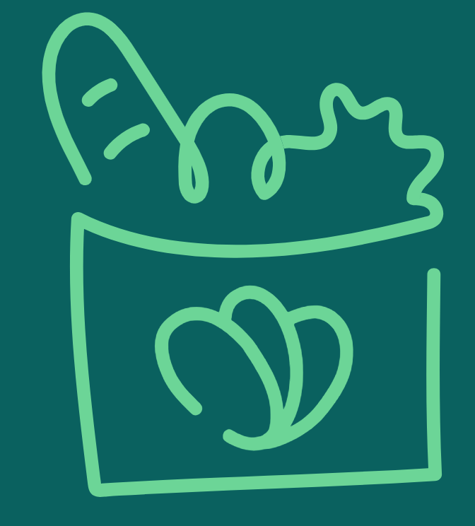
4
Meals saved per second
80,000
Meals go to waste worldwide
WE DREAM OF A PLANET WITH
no food waste
The gap is undeniable, but so is our potential for impact.
How can we better match supply and demand so we can save more meals from going to waste?
Notes:
Today we are here to
Background: Too Good To Go saves four meals per second. Yet in that same second, 80,000 more meals go to waste worldwide. The gap is undeniable, but so is our potential for impact.
Ask: So to get closer to this 80,000 meals saved and save more food, you have asked me how we can expand our impact across suppliers.
The challenge is that currently, there is no solution for the sales representatives to prioritize the type of suppliers in a way that best fits the demands of the market. This can slow down our growth to close the food waste gap.
Our in-depth analysis of supply and demand dynamics across store segments, item categories, and monthly trends reveals key opportunities to enhance market fit and refine supplier prioritization. By understanding where and what our customers are buying, we can strategically align our operations to maximize impact.

Slide 3
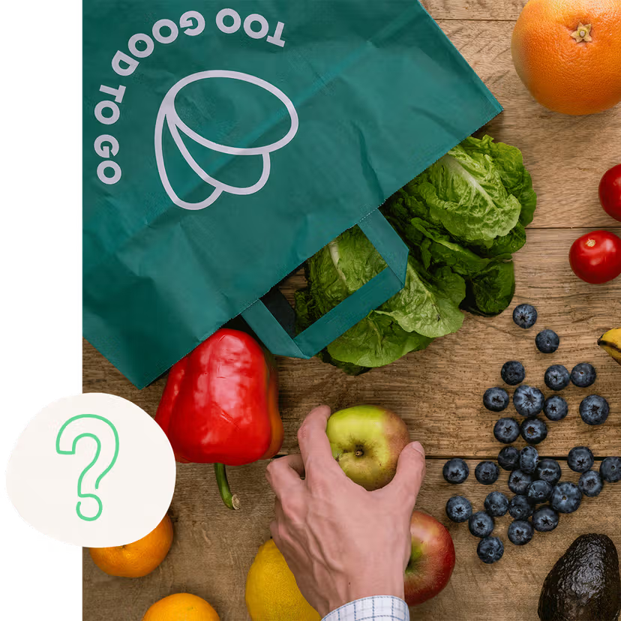
Why we’re here
To prioritize supplier types based on current market demands
In-depth analysis focussed on item and purchase data from 2019 until 2021
20K
Number of unique stores (aka Supply)
5.7M
Total number of magic bags sold (aka Demand)
Notes:
Today we are here to find a data-driven solution to support sales so that they can prioritize the supplier types based on the current demand. To do this, I’ve done an in-depth analysis focussing on item and purchase data ranging from 2019 until 2021. I’ve looked at the current supply, so the amount of stores across store segments (like bakery, supermarkets and restaurants) and at the demand, so the amount of magic bags sold. By matching the supply and demand numbers, key opportunities are revealed to enhance the market fit and refine supplier prioritization. In the upcoming slides, I’ll share the main strategic recommendations, a more in-depth analysis of the different supplier types and I’ll close with future next steps.
– Please be aware that for a fast-growing company like Too Good To Go, the data and insights that I’ll be sharing are considered a snapshot in time and therefore, the next best action can change quickly depending on market and demand changes. I want to avoid presenting insights that are not of actual use to the team so next to sharing data & insights based on the current market demands, I’ll be sharing a solution that we can use going forward to monitor the movement of supply and demand and flag critical changes to adapt our sales strategy.

Slide 4
Executive summary
Recommended strategic priorities for supplier alignment
1
2
3
4
Focus on onboarding stores in segments with relatively high demand & low supply
Look for suppliers in the medium supermarkets, offering groceries and meals.
Keep driving volume with dominant store presence
Bakery stores are pivotal to our store network and overall sales, leverage this by targeting bakery chains, offering both baked goods and meals.
Explore suppliers with a fast-growing demand & supply
Onboarding big supermarkets, manufacturers and beverages, as they indicate an emerging market demand.
Monitor remaining stores with low priority
Small supermarkets seem to have doubled in demand over from 2020 to 2021, indicating an early market demand

Slide 5
Prioritizing strategic partnerships
The order in which Sales reps can plan their time and effort
High Supply
High # Stores
1
Lowest priority
2
3
1
Highest priority
Low Supply
Low # Stores
Low Demand
Low Sales
High Demand
High Sales
Notes:
To help the team prioritize across different suppliers, I’ve set-up a prioritization matrix.
This prioritization matrix is divided into four squares, each with its own color and number. On the horizontal x-axis, you can see the demand, from low demand to high demand which could be translated to low and a high amount of sales. On the vertical y-axis, you can see supply, ranging from a low amount of stores to a high amount of stores.
The numbers represent the order which sales can use to prioritize which suppliers they need to reach out to first. Starting with number one as the highest priority and 4 with the lowest prority
In the next slide, I’ll plot the current supply and demand in a matrix like this using actual data, so that we can easily define which type of suppliers outbound sales could prioritize.
Before we dive into the data & insights, are there any questions or remarks so far?

Slide 6
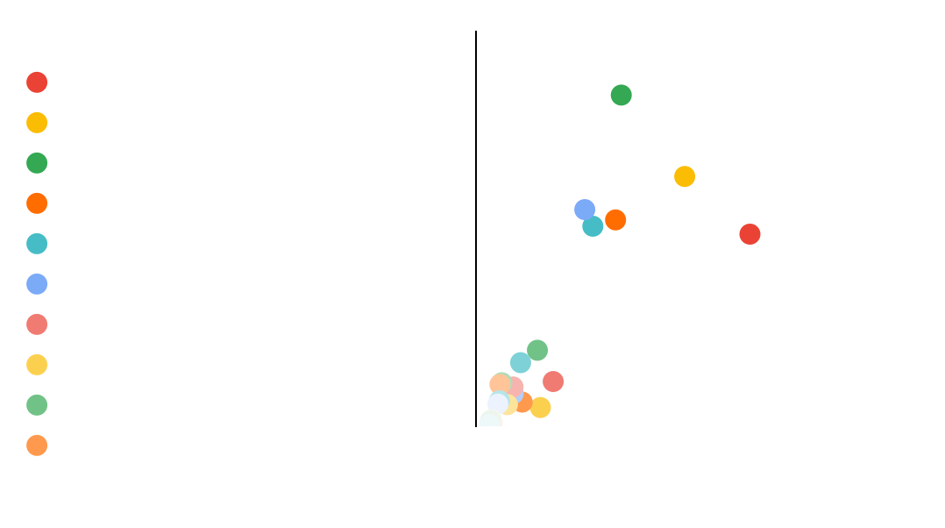
Medium supermarkets are in high demand, while the amount of stores is relatively low
Number of stores and number of bags sold split by store segment, 2021
2
The opportunity zone to grow supply
1
Notes:
I’d like to start by diving into the data for the so-called opportunity zone.
The first priority are all supplier types in the green box in the down right corner of the matrix. They have generated a relatively high amount of sales, while the amount of stores available on our platform is relatively low. This could indicate that there is a strong demand relative to the supply. It’s important to prioritize these type of suppliers since they indicate a need for more supply, to capitalize on the existing demand. In the case of the 2021 data that is used here, the medium supermarkets are in high demand but have low supply. Let’s dive into some more details about this segment

Slide 7
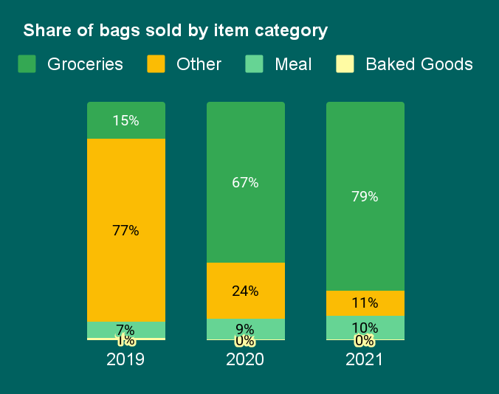
Target medium supermarkets part of a chain offering groceries and meals
ential. This category, though smaller in overall v
8%
Of total stores 2.3K of unique stores
14%
Of total sales 780K of magic bags sold
99%
Of magic bags sold by medium supermarkets are classified as chains
1%
Number of magic bags sold classified as vegetarian or vegan by medium supermarkets
Notes:
Medium supermarkets represent 8% of total stores and generate 14% of the total sales, almost entirely through chains. The best selling items are grocery items, specifically the ones without any dietary requirements since less than 1% of grocery items are tagged as vegetarian or vegan. Next to grocery items, it seems that meals are slowly increasing in sales, indicating an early market demand. Based on the current data, my advice would be to target medium supermarkets that are part of chain and offer both groceries and meals.

Slide 8
Bakeries are in high demand and have high supply: how we build more strategic partnerships?
Number of stores and number of bags sold split by store segment, 2021
2
2
Opportunity to differentiate
1
Notes:
The second priority are strategic targets and are the supplier types in the white box in the upper right corner of the matrix. These types generate a high amount of sales and so is the number of stores catering to it. This suggests a potentially competitive market. So even though there is already lots of activity in this corner, there might still be opportunity in differentiation or targeting underserved niches within this segment.
In the case of the 2021 data that is used here, the bakeries seem to be in high demand while having high supply. Let’s dive into some more details about this segment.
– High demand, high supply
This suggests a potentially competitive market. Opportunity might lie in differentiation.

Slide 9
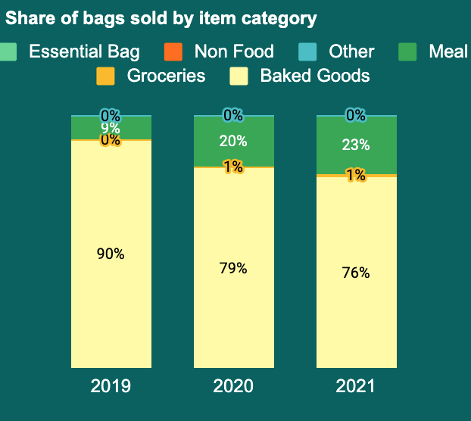
Target bakeries part of a chain offering baked goods and meals
19%
Of total stores 5.5K of unique stores
Share of bags sold by item category, 2020 vs 2021
23%
Of total sales 1.3M of magic bags sold
69%
Of magic bags sold by bakeries are classified as chains
<1%
Number of magic bags sold classified as vegetarian or vegan by bakeries
Notes:
Since the bakeries fall in the high supply and high demand category, there might be lots of competition from both the supply and demand side. Therefore, we can spot differentiating segments within bakeries that could help us grow the market even more. Bakery stores are pivotal to our store network and overall sales, constituting 19% of store locations. Moreover, they account for 23% of all bags purchased. To put this into perspective, almost 1 out of 4 of bags sold are sold in bakeries across the market. Most of the sales are generated through chains. The best selling items are baked goods items, specifically the ones without any dietary requirements since less than 1% of bakery items are tagged as vegetarian or vegan.
When looking at the share of items sold over time, it is clear that bakeries are specialized in baked good. In addition to baked goods, it seems like meals are emerging within bakeries as well, since they doubled in their share of sales from 9% of total sales to 23%. Therefore, my recommendation is to target bakeries within chains, offering both baked goods and meals.

Slide 10
Several segments are in relatively low demand and low supply: there may be emerging trends
Number of stores and number of bags sold split by store segment, 2021
2
Opportunity to spot emerging trends
3
1
Notes:
The third priority are the suppliers in the yellow box in the down left corner of the matrix. On average, these segments have a low supply and low demand. However if we notice that the demand in this corner is steeply increasing in a short amount of time, it indicates an emerging trend that we can capitalize on even further.
In the case of the 2021 data that is used here, there many store segments that seem to be in relatively low demand while having low supply. Let’s dive into some more details for these stores to see which suppliers offer trending items that we can capitalize on to respond to emerging market needs.

Slide 11
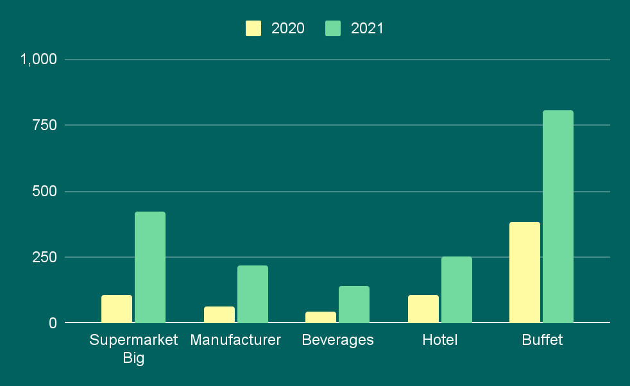
Add more high risers in our supply to capitalize on emerging market needs
Top five segments with the highest average number of bags sold per store YoY, 2020 vs 2021
+111%
+298%
+254%
+137%
+207%
Notes:
Here you can see the so-called high risers. On the horizontal x-axis you can see five different supplier types and on the vertical y-axis, the average amount of bags sold by amount of stores. By comparing the average bags sold by store per year, we can see a steep year on year growth for these segments. My recommendation is to target these suppliers as they seem trending and we can capitalize on this emerging market needs by adding more suppliers in this segment.

Slide 12
Several segments are in relatively low demand and low supply: there may be emerging trends
Number of stores and number of bags sold split by store segment, 2021
4
2
Low priority due to relatively sufficient supply
1
Notes:
Lastly, the suppliers with the lowest priority are found in the red box in the upper left corner of the matrix. There are already plenty of suppliers, but the demand is relatively low. This could indicate over-saturation or low market interest.
In the case of the 2021 data that is used here, the fruits & vegetables stores, fast food restaurants and small supermarkets seem to be in relatively low demand while having high supply. So unless there are specific reasons to target these suppliers, these might be a low-priority segment for outbound sales. Let’s investigate these segments a bit more in the next slide.

Slide 13
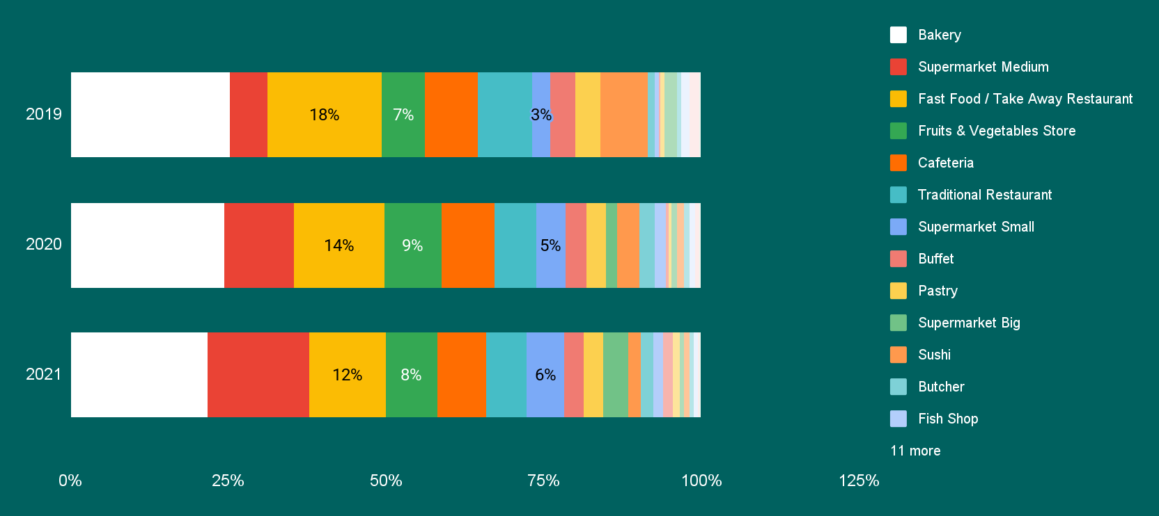
Low priority suppliers are stable in demand, indicating no direct need for more supply
Share of bags sold by store segment, 2019 until 2021
Notes:
Here we are looking at the share of bags sold over the years. Let’s focus on the low priority segments. In the yellow boxes we can find the share of sales for fast food restaurants, which decreased it share of sales from 18% to 12%. Next to it are the green boxes representing the fruits and vegetables stores, this segment is relatively stable and hovers around 8% of total sales across the years. For small supermarkets there seems to be an increasing demand, as the share of sales has doubled from 3% to 6%. Therefore, I would recommend to consider small supermarkets to be onboarded as well by the sales team.

Slide 14
Prioritizing strategic partnerships
The order in which Sales reps can plan their time and effort
1
Focus on onboarding stores with high demand and low supply
2
Look for scalable, strategic stores to build on high demand and high supply
3
Explore emerging stores with fast growing demand & supply
4
Monitor the remaining stores with low priority
Notes:
And that concludes our deep-dive! To recap, I’ve given you several suggestions on which supplier types to reach out to based on a specific order.
I recommend to first onboard stores with high demand and low supply, then look for scalable strategic stores, like bakery chains.

Slide 15
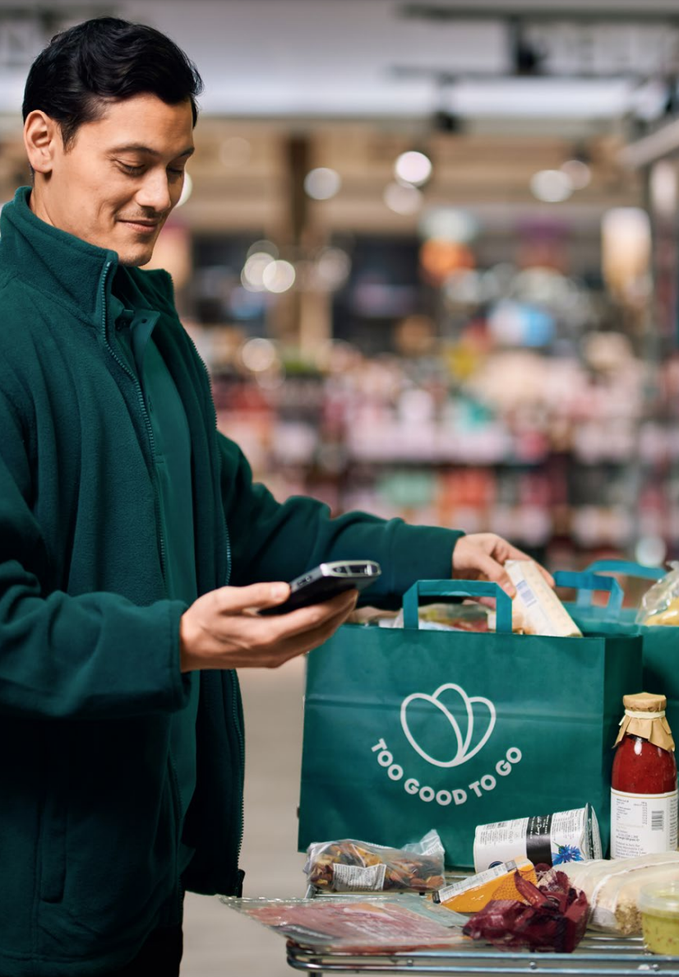
What if our sales reps receive recommendations that
Provide sales reps with clear, actionable guidance on which store segments and item categories to onboard to boost sales based on current supply and historical demand.
Potential Actionable Insights for Sales: *
“Prioritize suppliers offering Bakery with Baked Goods, as these are in high demand."
"Look for Sushi suppliers that offer “Vegetarian” items, as these show a strong upward trend in purchases."
“We’ve got plenty of Supermarket Medium suppliers. However, chains do bring in lots of new customers so keep your eyes open for strategic partnerships.”
* fictional examples
Notes:
What if we can empower the Outbound Sales team to become more strategic about the types of suppliers they prioritise in line with demand of the markets? What is they receive recommendations that provide clear, actionable guidance on which store segments and item categories to onboard to boost sales based on historical demand? This way we could add more suppliers when there is more demand, but also keep our eyes open for strategic partnerships and trending items to capitalize on emerging market needs.

Slide 16
Potential future next steps
Let’s move towards a more strategic, data-informed approach
Set-up a feedback loop & training
Do the data-driven priorities align with their experience? Does it make sense to them?
1
Integrate data
Develop an interactive dashboard for Outbound Sales reps and/or integrate with Sales workflow such as Salesforce. Track critical changes in quadrants.
2
Consider more data points such as
· Out of stock levels
· Average supplier acquisition cost (effort and costs for onboarding)
· Supplier retention (across segments)
· Geographic data (across markets, cities)
· Store performance metrics (nps, customer ratings)
· + suggestions from stakeholders
3
Notes:
To make this project a success, I think the most important next step would be is to set-up a feedback loop with the sales team. By talking to the sales reps, I would like to check if these data-driven priorities align with their experience, but also if a solution like this matrix would really help them prioritize their work.
Next, we could develop an interactive dashboard and set-up critical changes in the matrix, so that all the relevant people can get a notification or regular update send to them to adjust their sales strategy.
Last but not least, there is so much more data that could elevate the outcome. I’ve listed a few ideas such as adding out of stock levels, costs, retention, geographic and store performance data, and ofcourse I’m happy to hear yours as well. This concludes the deepdive so far, I’m very curious to hear your thoughts or concerns. –
Please be aware that for a fast-growing company like Too Good To Go, a matrix like this shows a snapshot in time and can quickly change. Therefore, when we agree to use a matrix like this in the future, we will have to monitor the movement of categories or segments between these quadrants and flag critical changes to adapt our sales strategy accordingly.

Slide 17
Thank you!
Any questions or remarks?
By Roos Rabenberg

Slide 18
Appendix

Slide 19
Empowering Outbound Sales to prioritize high-value suppliers based on market demand
Background
Too Good To Go saves four meals per second. Yet in that same second, 80,000 more meals go to waste worldwide. The gap is undeniable, but so is our potential for impact.
Ambition
Save more food by expanding our impact across suppliers aligned with market demand.
Challenge
Currently there is no solution for the sales reps to prioritize the type of suppliers in a way that best fits the demands of the market. This can slow down our growth to close the food waste gap.
Objective
What if we can empower the Outbound Sales team to become more strategic about the types of suppliers they prioritise in line with demand of the markets?
1
What are market demand characteristics?
2
What are supplier characteristics?
3
How to connect demand and supply?
Output
The supplier compass: your guide to strategically find suppliers based on demand

Slide 20
It’s all about balancing supply with demand
Imagine a lever, with demand and supply on either side
Demand
Supply

Slide 21
In this example, the demand is equal to supply
This means demand and supply are relatively balanced
Demand: 10
Supply: 10
10/10=
1

Slide 22
Now the supply increases from 10 to 15
More supply, but relatively little demand. No more supply needed
Demand: 10
10/15=
0.7
Supply: 15

Slide 23
Let’s flip it: the demand increases from 10 to 15
More demand, but relatively little supply. There is opportunity here!
Supply: 10
15/10=
1.5
Demand: 15

Slide 24
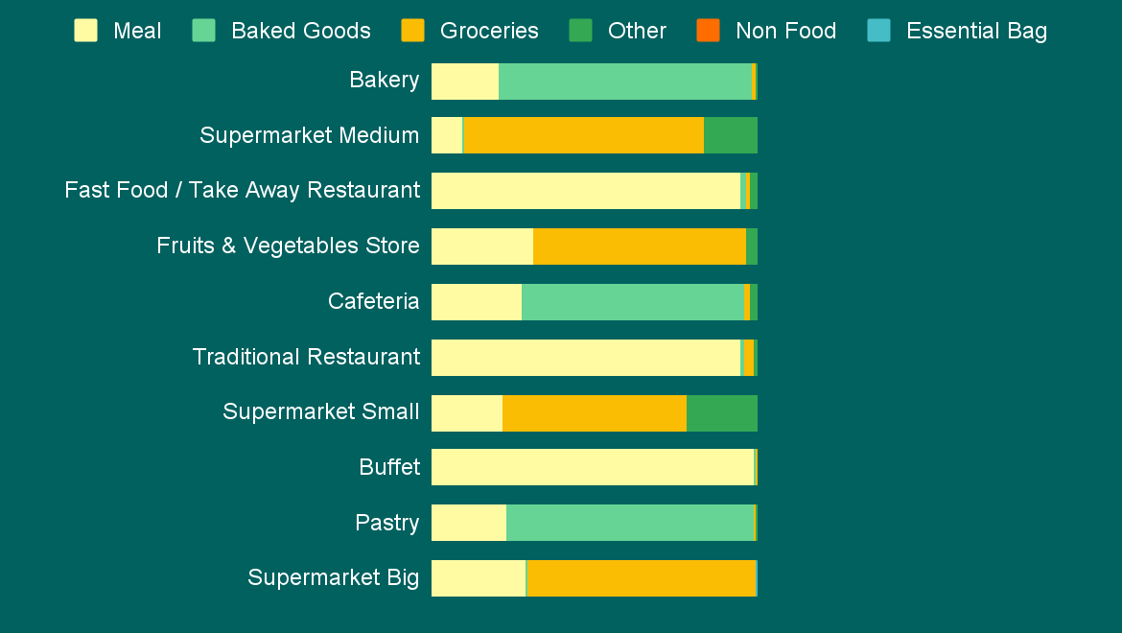
The most popular store segments are specialized for distinct item categories
Top 10 store segments by item category (# bags sold), 2019-2021
21% 78%
10% 74% 16%
95%
31% 65%
28% 68%
95%
22% 57% 21%
99%
23% 76%
29% 71%
· Meals are sold by most stores. Specialized segments are takeaway restaurants (95%), traditional restaurants (95%) and buffet (99%)
· Baked goods are mostly sold by bakeries (78%), cafeterias (68%) and pastry (76%).
· Groceries are mostly sold by supermarket medium (74%), supermarket small (57%) and supermarket big (71%) and fruit & vegetable stores (65%).
· Supermarkets Medium and Small sell quite a share of Other item categories (16% and 21%). Further analysis can reveal details on these items.
Notes:
There are 24 different store segments that we use to divide our current supply types. Here you can see the top 10 supplier types and their sales mix across item categories. Most of these offerings are expected for the supplier type. For example, the first bar we see all stores categorized as a bakery, where 21% of their total bags sold are from meals, whereas the majority comes from baked goods, which makes sense for a bakery. To summarize the current demand by supplier, we can see that restaurants demonstrate a significant specialization in meals, which represent a substantial portion of their total bags sold, while bakeries, cafeterias and pastry stores show a notable preference for baked goods.
One item I want to highlight is the one called “Other”, to date, it is unclear what kind of items these are and since both the medium and small supermarkets sell a relatively high share to “other item categories”, a future analysis could reveal more details on this.
Now we are a bit more familiar with the data that we are looking at and we understand that different suppliers are specialized in different items

Slide 25
Prioritizing strategic partnerships
The order in which Sales reps can plan their time and effort
1
High demand, low supply
Indication of strong demand relative to the supply. Prioritize these type of suppliers.
High Supply
4
2
2
High demand, high supply This suggests a potentially competitive market. Opportunity might lie in differentiation.
3
Low demand, low supply
Target suppliers who offer these trending items to capitalize on emerging market needs.
3
1
Low Supply
4
Low demand, high supply
Unless there are specific strategic reasons to target these suppliers, these might be a low-priority segment for outbound sales.
Low Demand
High Demand
Notes:
So to help the team prioritize across these different suppliers, I’ve set-up a prioritization matrix.
This prioritization matrix is divided into four squares, each with its own color and number. On the horizontal x-axis, you can see the supply, from low supply to high supply. On the vertical y-axis, you can see demand, ranging from low demand to high demand.
In a later slide, I’ll plot the supply and demand in a matrix like this, so that we can easily define which type of suppliers outbound sales could prioritize.
To account for changes over time, we’ll also explore segments that show critical changes that can help us to adapt the sales strategy accordingly.
The numbers represent the order of preference based on strategic insights one can distill using supply and demand characteristics.
The first priority are all supplier types in the green box in the down right corner of the matrix. They have generated a relatively high amount of sales, while the amount of stores available on our platform is relatively low. This could indicate that there is a strong demand relative to the supply. It’s important to prioritize these type of suppliers since they indicate a need for more supply, to capitalize on the existing demand.
The second priority are the supplier types in the white box in the upper right corner of the matrix. These types generate a high amount of sales and so is the number of stores catering to it. This suggests a potentially competitive market. So even though there is already lots of activity in this corner, there might still be opportunity in differentiation or targeting underserved niches within this segment.
The third priority are the suppliers in the yellow box in the upper left corner of the matrix. There are already plenty of suppliers, but the demand is relatively low. This could indicate over-saturation or low market interest. But if the demand in this corner is steeply increasing in a short amount of time, it indicates an emerging trend that we can capitalize on even further.
The suppliers with the lowest priority are found in the red box in the down left corner of the matrix. There seem to be relatively low demand and supply and unless there are specific strategic reasons to target it, these suppliers would have the lowest priority.
Now, the idea for the next couple of minutes is to go over each of these priorities and dive deep into the data to see which supplier types the outbound sales teams could try to onboard. I’ll close of with future next steps, Before I continue, are there any questions or remarks before we dive into the data & insights?

Slide 26
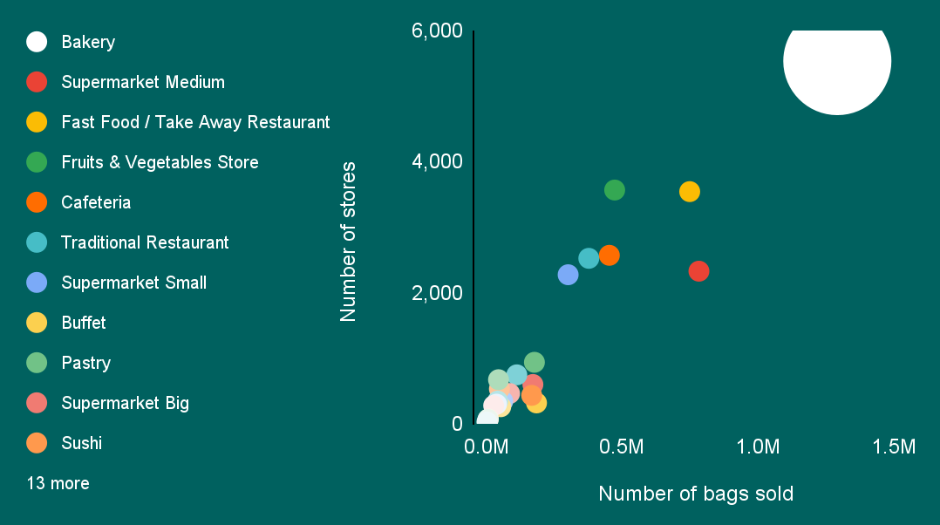
High-level recommended strategic priorities for supplier alignment
Number of stores and number of bags sold split by store segment, 2019-2021
1. Medium supermarkets show opportunity due to their relatively low supply and high demand
2. Bakeries have high amount of sales and stores, how can we differentiate our offerings further?
3. Investigate high risers
4. Fruits & vegetables stores and fast food restaurants show potential if demand increases

Slide 27
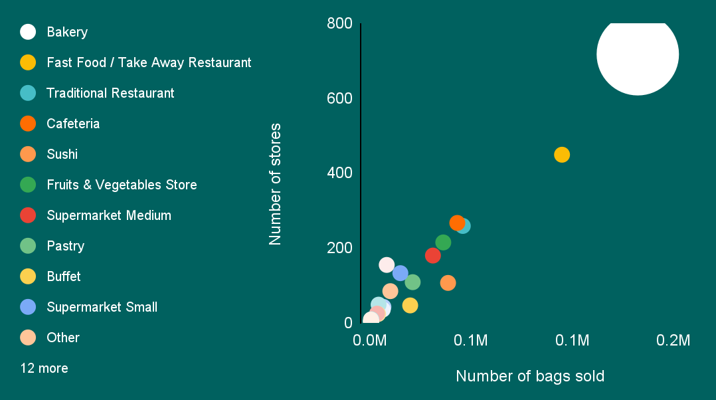
Number of stores and number of bags sold split by store segment, 2019

Slide 28
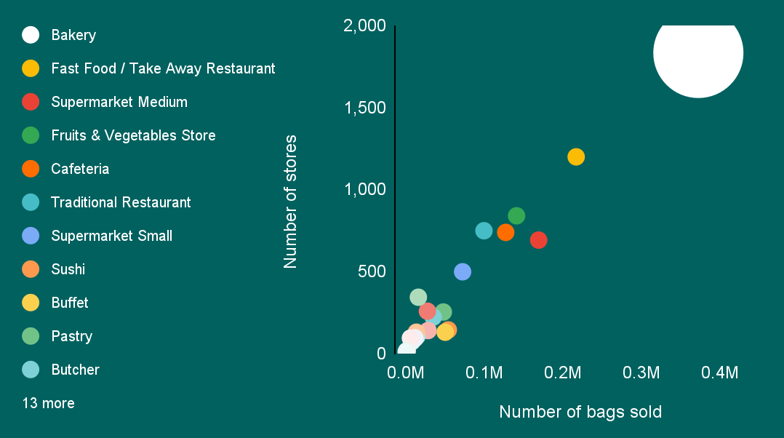
Number of stores and number of bags sold split by store segment, 2020

Slide 29
Number of stores and number of bags sold split by store segment, 2021

Slide 30
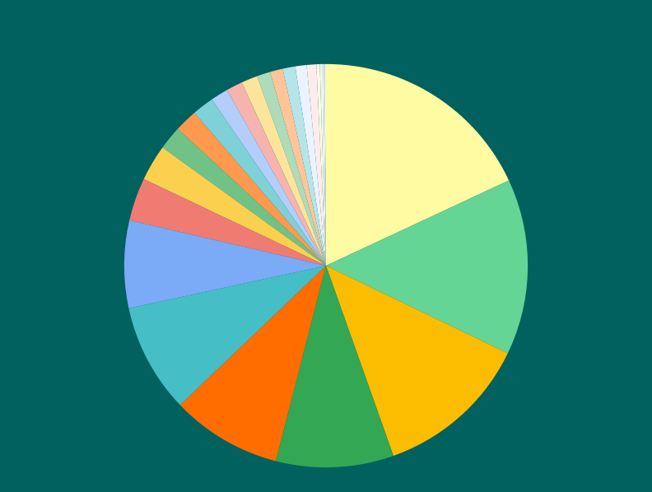
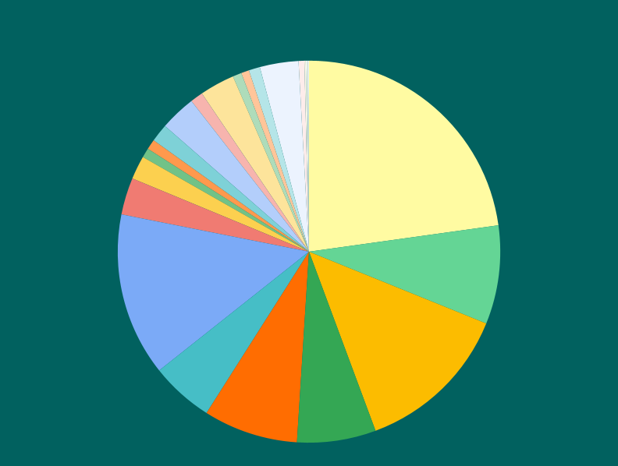
Bakery stores constitute 18% of store locations, and account for 23% of all bags purchased
Number of stores by segment, 2019-2021
Number of bags sold by segment, 2019-2021
Bakery
18%
Bakery
23%
Fruits & Vegetables
14%
Fruits & Vegetables
8%
Fast Food
12%
Fast Food
13%
The critical role of bakery stores in both our operational stores and overall sales performance showcases the need for continuous targeted support and strategic supply prioritization.
Notes:
The market shows clear distinctions in demand patterns across different store segments. Supermarkets and Convenience stores consistently represent the largest share of overall stores, purchases, and bags sold, indicating their crucial role in our supply chain.

Slide 31
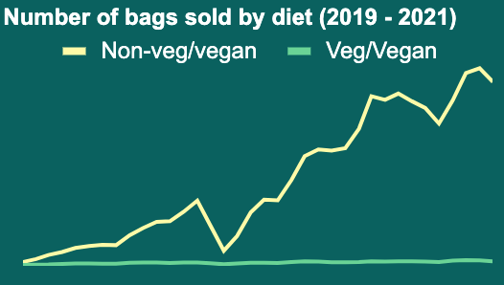
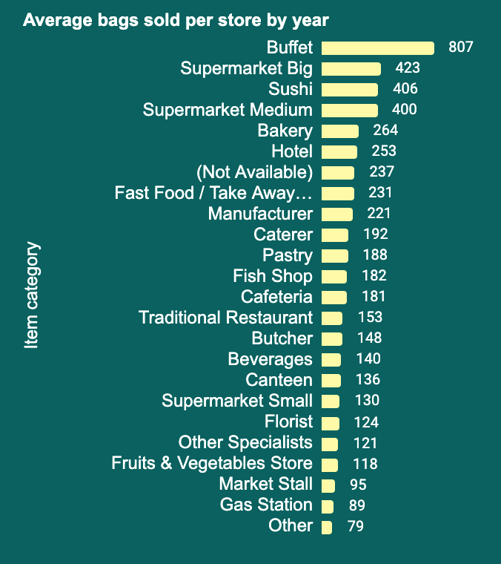
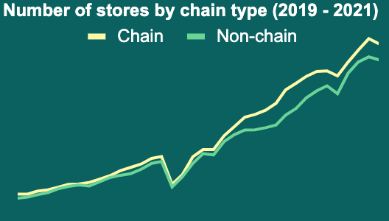
Average bags sold per store by store segment, 2019-2021

Slide 32
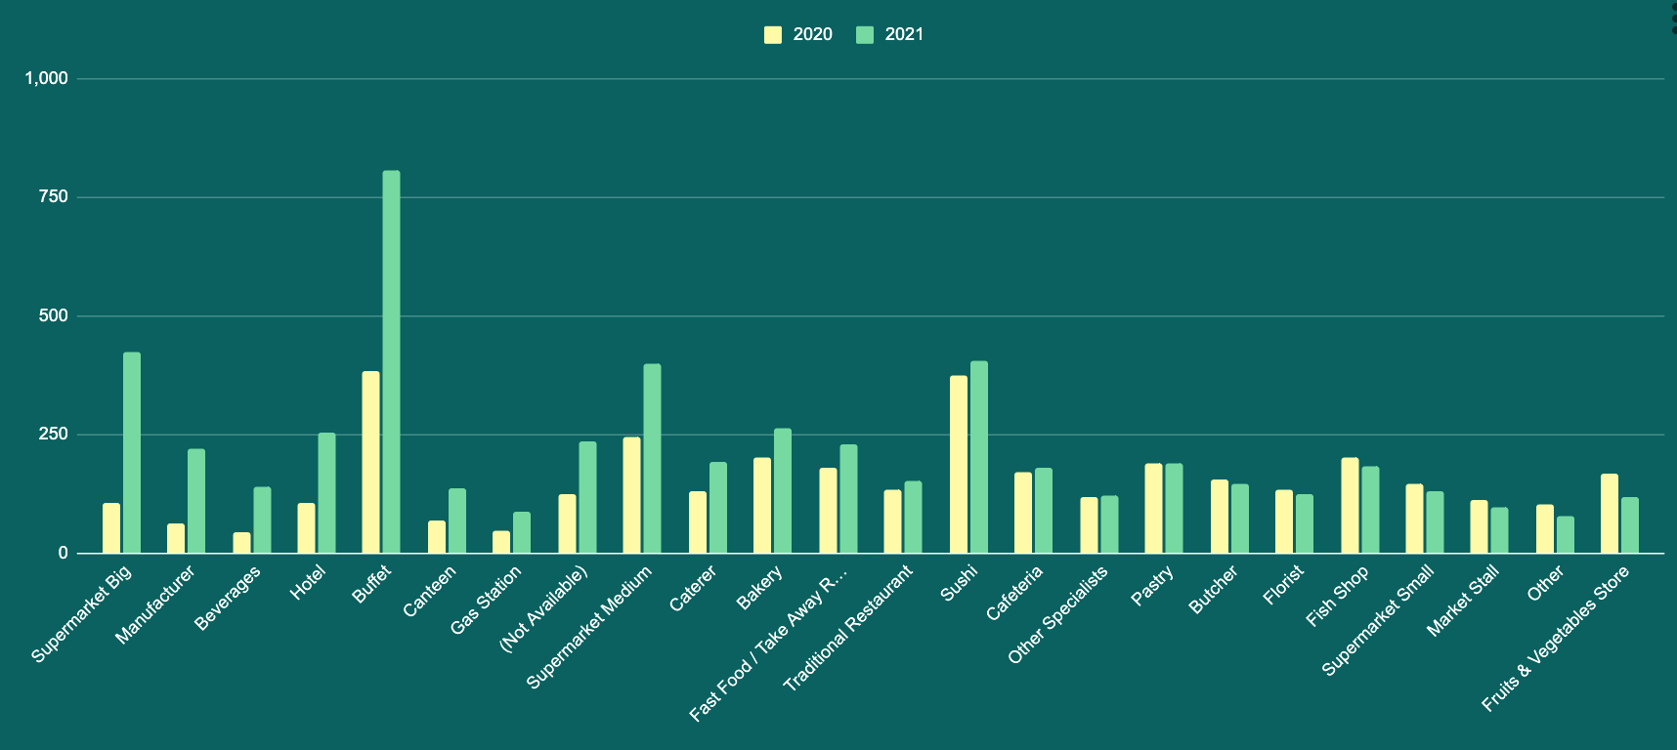
Average number of bags sold per store by segment YoY, 2020 vs 2021
+111%
+298%
+64%
+30%
+9%
+254%
+137%
+89%
+28%
+5%
0%
-8%
-10%
-16%
+92%
+45%
-30%
+207%
+15%
+2%
-6%
-10%
-24%
+90%

Slide 33
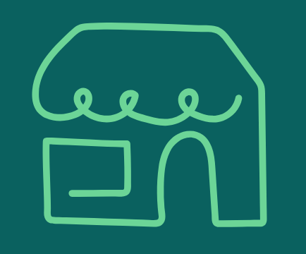

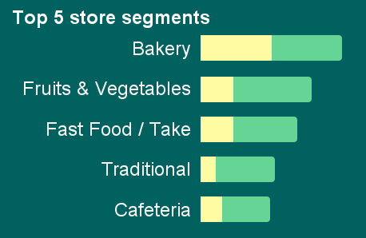
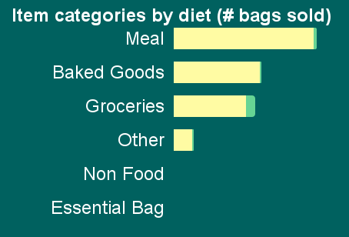
+20K
Stores of which 8% are chains
+5.1M
purchases
+5.7M
magic bags purchased
The highlights
Chain
Non-chain
Based on item and purchase data from 2019 until 2021. Future analysis can expand to more data points.

Slide 34
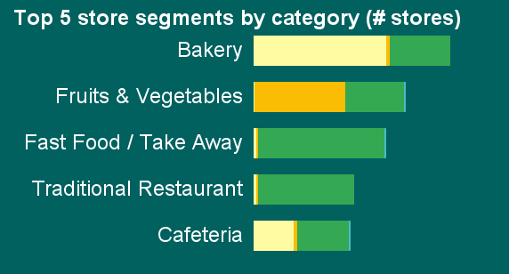
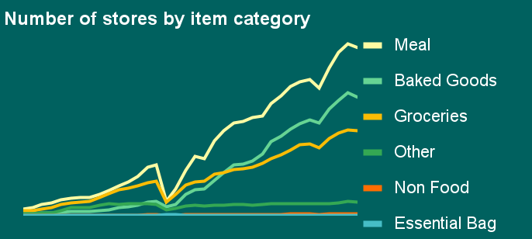
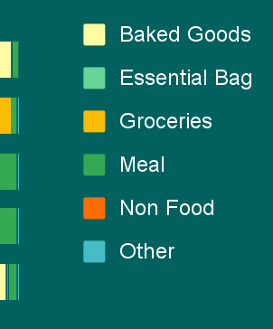
24
Store segments
+20K
Active stores
44%
Active chain stores
the supply
Based on item and purchase data from 2019 until 2021. Future analysis can expand to more data points.

Slide 35
871K
Active users
+23K
Unique items
+5.7M
magic bags purchased
the demand
Active users
Add categories
Add trends over time?
Based on item and purchase data from 2019 until 2021. Future analysis can expand to more data points.
Notes:
Demand
871K users with purchases
23K unique items purchased
6 item categories (meals, groceries, …)
3 diet categories (none, veg, vegan)

Slide 36
What are market demand characteristics?
Defining high and low demand
High demand
The categories with the highest purchase volume and quantity sold
Focus on onboarding new suppliers who offer items in these popular categories.
Actionable Insight for Sales: "Prioritize suppliers offering [Top Item Category 1], especially [Specific Diet Category if applicable], as these are in high demand."
Low demand
Potentially emerging categories whose purchase frequency is significantly increasing over time.
Target suppliers who offer these trending items to capitalize on emerging market needs.
Actionable Insight for Sales: "Look for suppliers with [Specific Item Category] that shows a strong upward trend in purchases."

Slide 37
What are supplier characteristics?
Defining high and low supply
High supply
Determine if certain supplier characteristics (e.g., store_segment, chain_id, item_category, item_diet_category) are associated with higher overall purchase volume or average quantity per purchase across their offerings.
If certain store segments consistently sell more, prioritize onboarding more suppliers from those segments.
Actionable Insight for Sales: "Focus on onboarding suppliers that fit the profile of successful stores, such as those in the [Specific Store Segment] category."
Low supply
Analyze if certain store_segments or regions have a high purchase volume but a limited number of suppliers offering relevant items.
Identify opportunities to onboard suppliers in these underserved areas or segments.
Actionable Insight for Sales: "Explore opportunities to onboard suppliers in [Specific Store Segment] as there's high demand but potentially fewer options."

Slide 38
Data dictionary
items.csv
purchases.csv
item_id | unique identifier for an item
item_category | the type of supply being offered
item_diet_category | if applicable, the dietary category of the item
store_id | unique identifier for the store that is offering the given item
store_segment | the category of store
chain_id | if applicable, the unique identifier for the chain that the given store is a part of
purchase_id | unique identifier for a purchase
user_id | unique identifier for the user that completed the given purchase
date | the date of the given purchase
item_id | unique identifier for an item
stock_count | the number of magic bags purchased

